Slide 1














Brief Report

Slide 2
Language used:
Java
Task 1:
Screen Lock Possible Patterns
Uses the adjacency and indirect paths of the points to ensure that each pattern respects the grid’s movement rules.
It generates all possible permutations of the points for the required length and then filters these permutations to include only valid paths that start, include, and end with specified labels.

Slide 3
Steps:
01
02
03
04
05
Define the grid's adjacency relationships and indirect paths.
Check if paths are valid based on adjacency and previously passed nodes.
Generate permutations of remaining labels to explore all potential patterns.
Insert start, middle, and end labels into permutations to form complete patterns.
Validate these patterns and collect the valid ones for output.

Slide 4
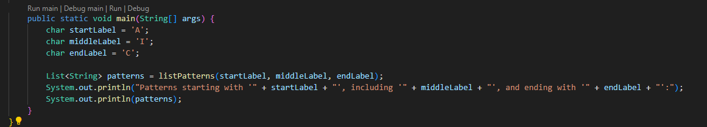
Input for listPatterns
Output sample

Slide 5

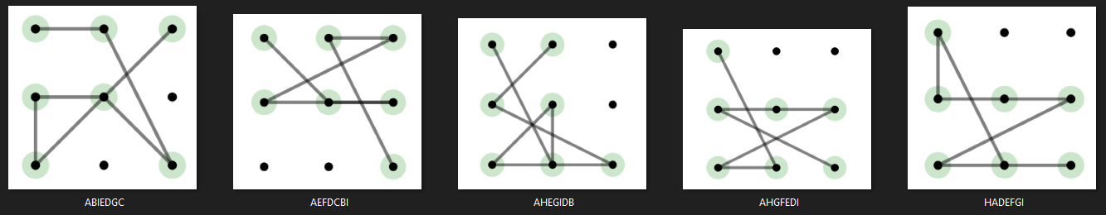
Validation check (Console) “AHEGIDB”
Validation check (Visual)

Slide 6
Genetic Algorithm
Task 2a:
Route Algorithm
Minimize total cost to meet all demand

Slide 7
Steps:
01
02
03
Change early_stop to False for more generation (in Function solve)
Make sure crossover does not happen between identical elements (in Function mutate)
Change parameters:
Population size, selection size, elite size, number of generations, mutation rate and crossover rate

Slide 8
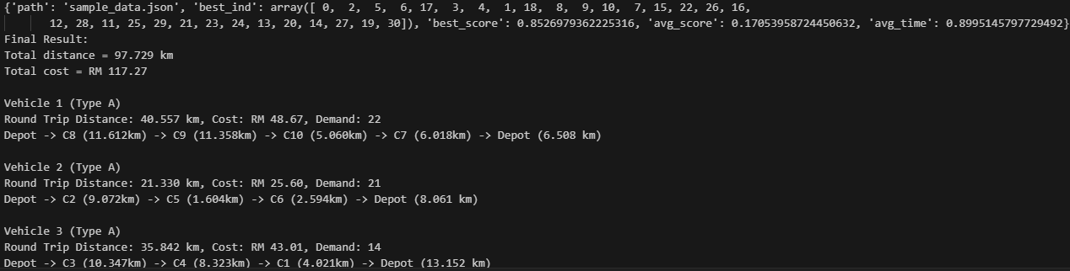
Result 2a

Slide 9
Genetic Algorithm
Task 2b:
Route Algorithm
Satisfy as many demands as possible

Slide 10
Steps:
Similar to Task 2a, main difference is in calc_fitness, to add the weight for demand and cost (Prioritize demands)

Slide 11
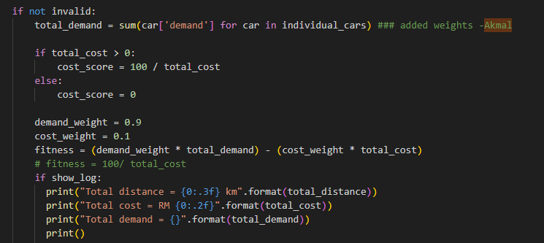
weights to prioritize demand over cost

Slide 12
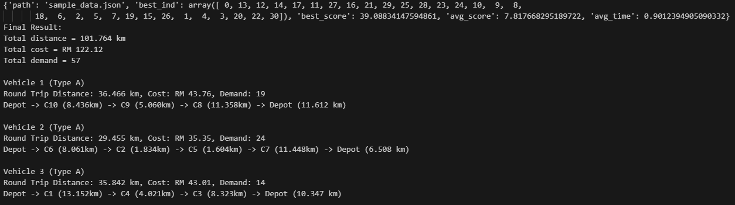
Result 2b

